Slide 1

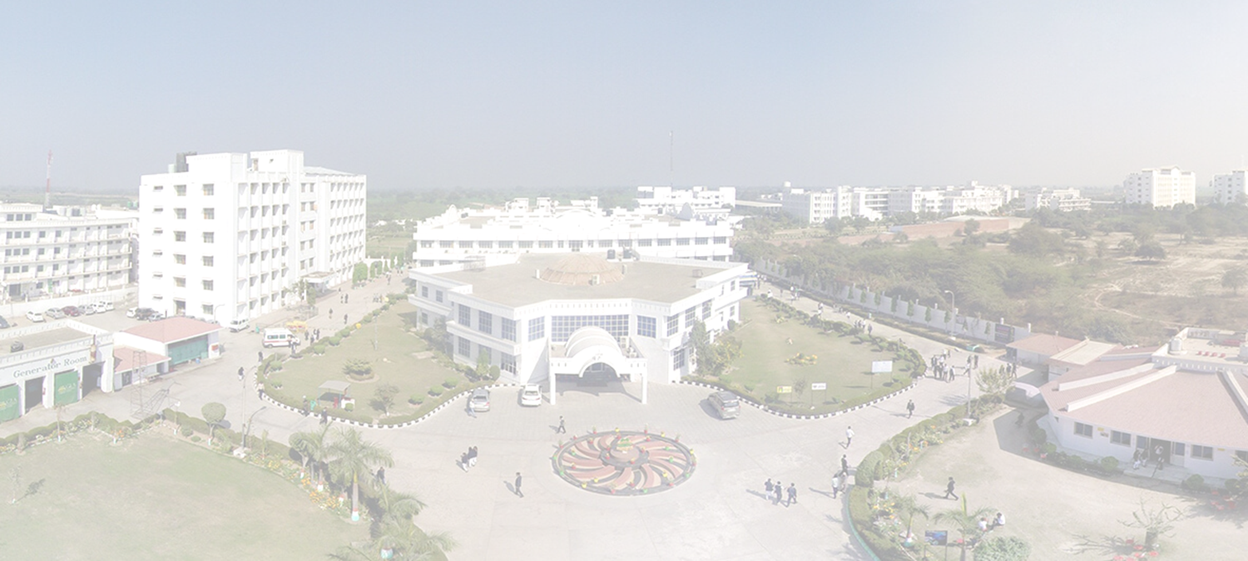
GLA UNIVERSITY
PROJECT PRESENTATION

Slide 2
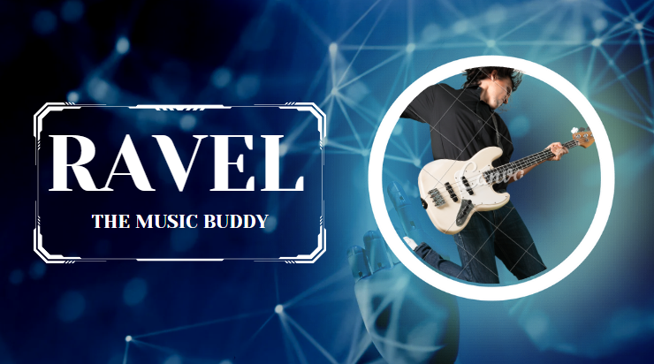

Slide 3
Submitted By :-
Abhishek Sagar (I) - 2115000026
Aditya Singh (C) - 2115000078
Aman Kumar (J) - 2115000130
Sikha Chauhan (E) - 2115000995

Slide 4
Submitted To :-
Mr. Ankit Arora
Assistant Professor
Department of CEA

Slide 5
INTRODUCTION

Slide 6
The ultimate music website for all the users to embark on a musical journey like never before.
At Ravel, we've created a space where listening to music is easier and for free.
It is more than just a music platform; it consists of a passionate community of music enthusiasts, curators, and artists dedicated to bring users the very best in melody and rhythm.

Slide 7
Let's dive into a world of melody and rhythm.
Are you ready to embark on musical journey?
Let the exploration begin! 🌟

Slide 8
OBJECTIVE

Slide 9
Create a user-friendly interface that allows users to easily discover, organize, and play their favorite music tracks.
Implement a robust recommendation system that suggests music based on user preferences.

Slide 10
WHY WE MADE THIS PROJECT?

Slide 11
This college project was initiated with a strong emphasis to provide a user-friendly web-based interface that allows users to search and add their favorite artists, genres, and songs to tailor recommendations. The system will Build a comprehensive music database with a vast collection of songs, albums, and artists and will also categorize music by genre, mood, and other relevant metadata. It also includes feature to download the songs and provides good-quality audio streaming for users.

Slide 12
Methodology

Slide 13
Methodology:
Frontend Development: Our frontend will be created using HTML and CSS for building the user interface.
Backend Development: We will employ JavaScript for the backend development.
API: It will provide other functionalities like searching music tracks, download songs in high quality, etc.

Slide 14
FEATURES

Slide 15
Listening History: Keep track of the songs, albums, and artists users have previously listened to.
Search Functionality: Enable users to search for specific songs, albums, or artists.
Free of cost: Free for use.
Download: Users can download the songs they like.

Slide 16
CODE SNIPPETS

Slide 17
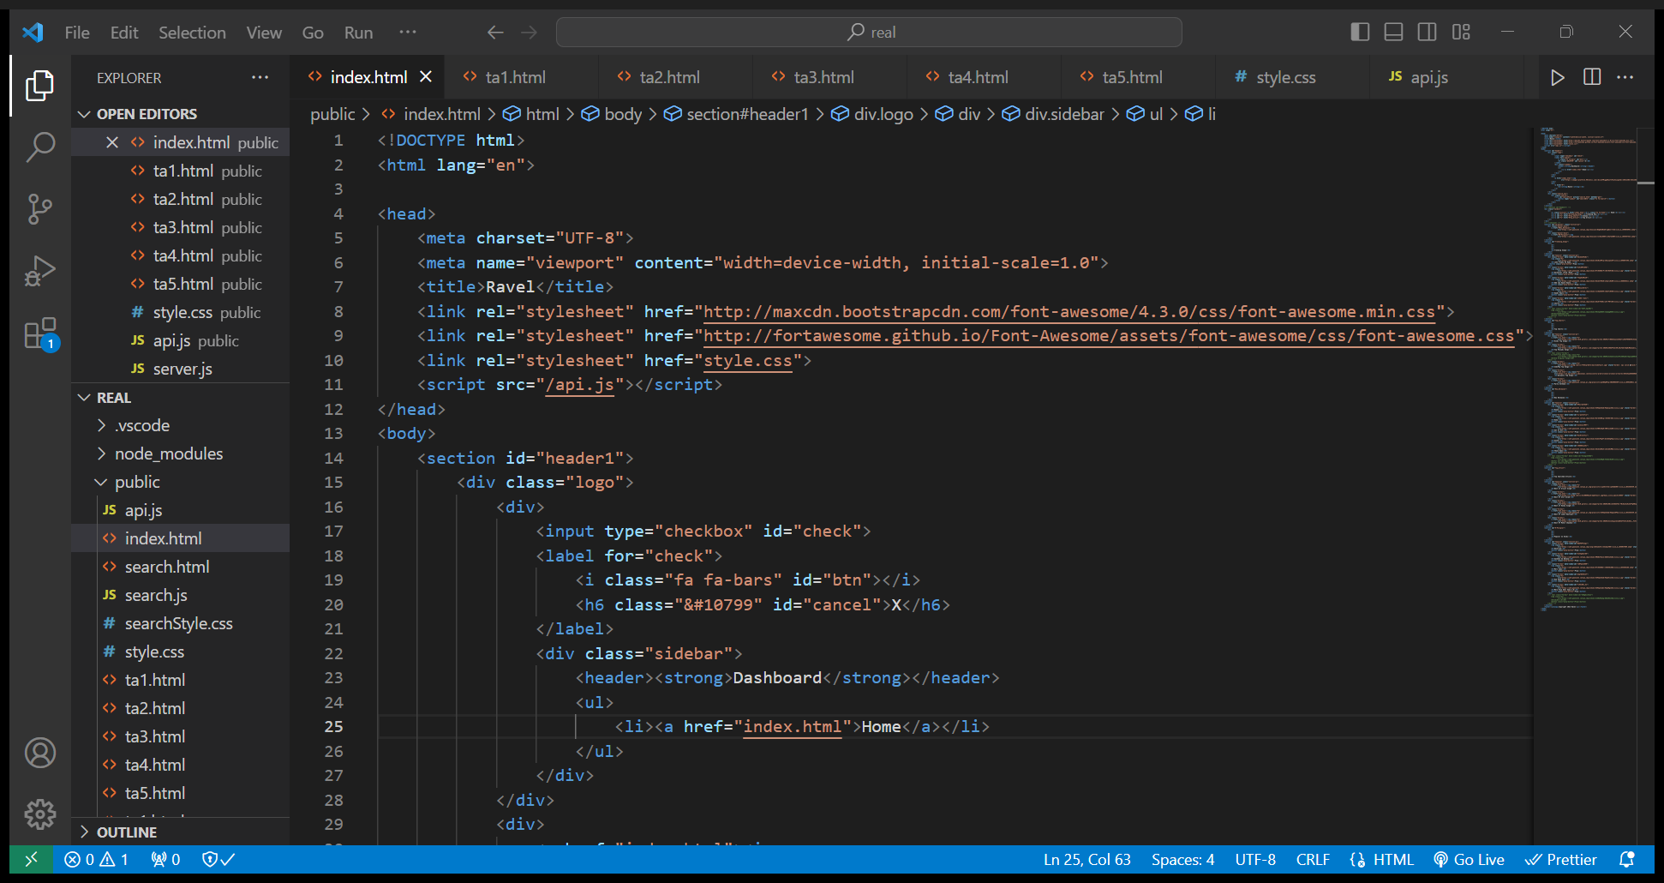

Slide 18
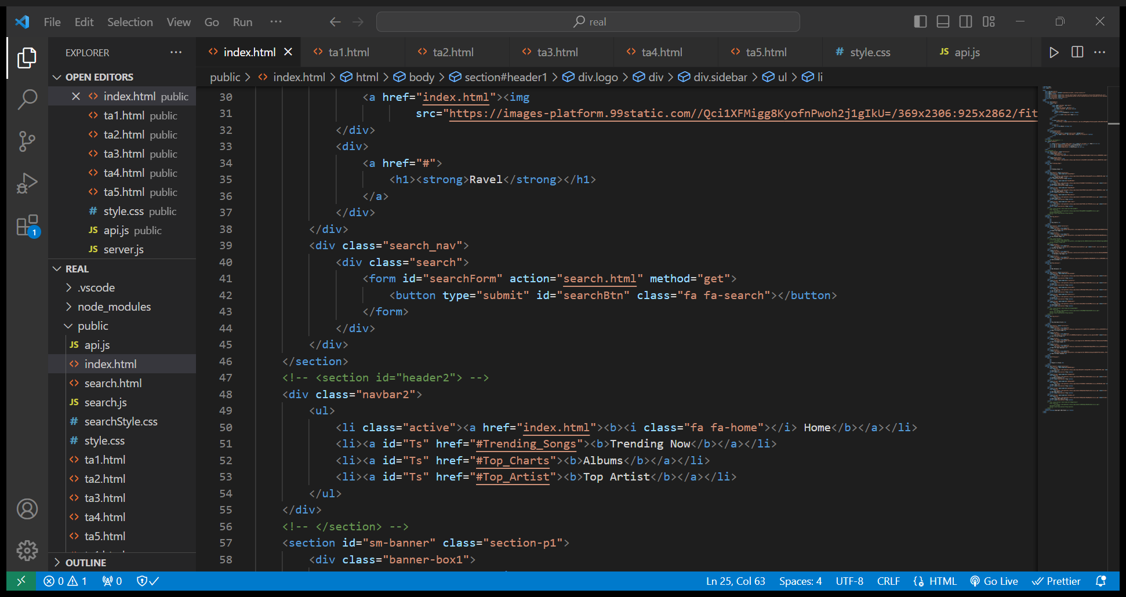

Slide 19
SOME DESCRIPTION ABOUT THE PROJECT

Slide 20
Getting Started:
Visit the Ravel : The Music Buddy website.
Song Selection:
Explore our intuitive and user-friendly interface designed to enhance your music exploration. Easily navigate through an extensive library of artists, albums, and tracks, or let our personalized recommendations guide you to new and exciting auditory discoveries. Immerse yourself in high-quality audio streaming, making every note and lyric resonate with crystal-clear precision.

Slide 21
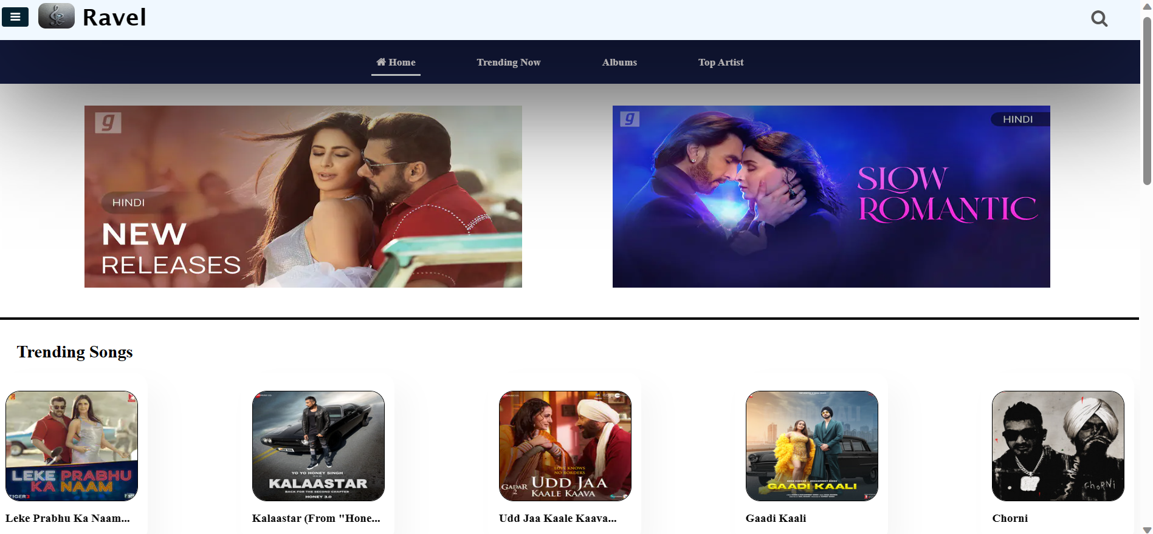

Slide 22
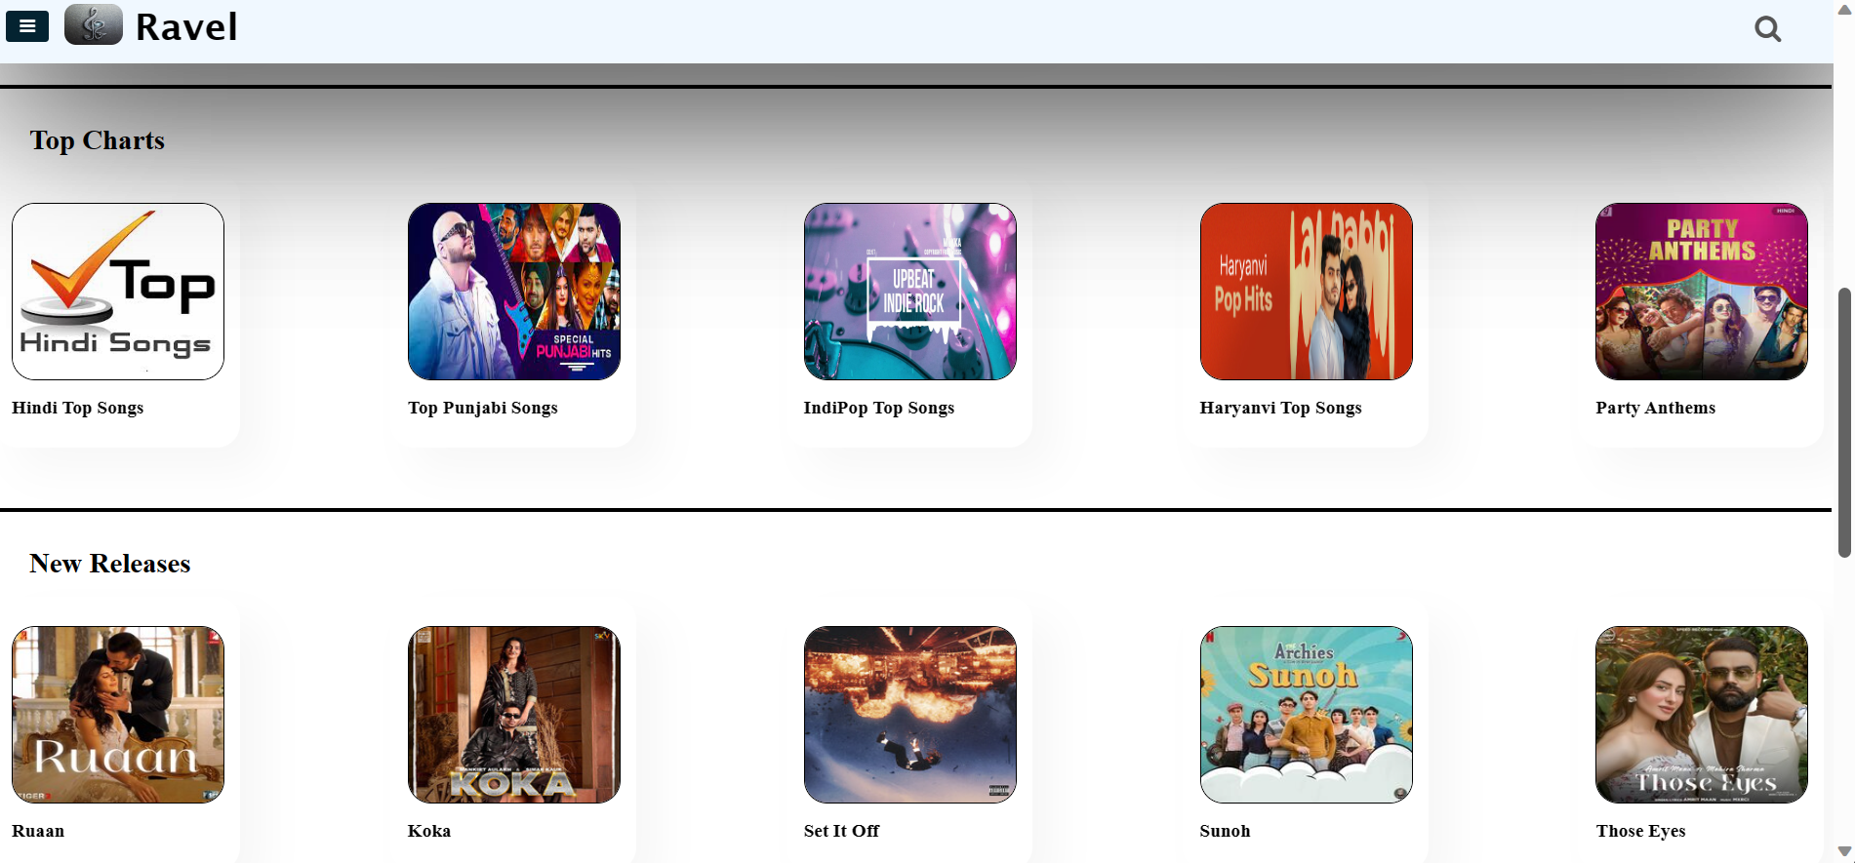

Slide 23
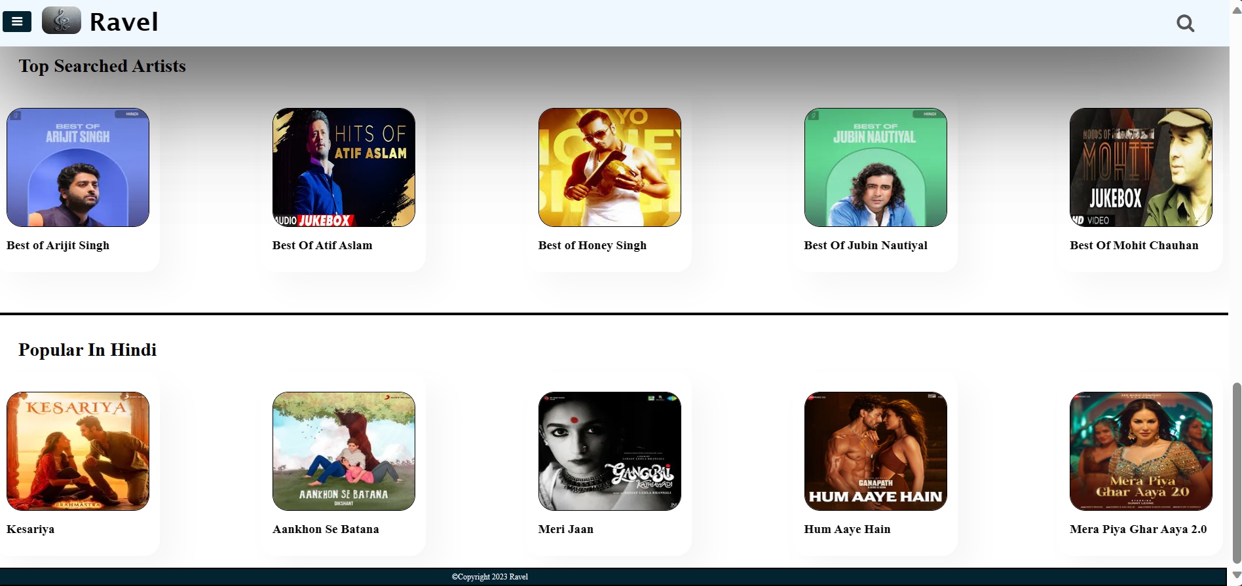

Slide 24
FUTURE WORKS
Database :- to save user’s data.
Playlist Creation:- so that user can save their favorite songs in particular playlists.
New Songs:- new songs as per more different categories will be added.

Slide 25
SUMMARY

Slide 26
“Ravel” is not just a platform; it's a celebration of the universal language that transcends boundaries and connects us all. Join us on this sonic adventure, where every click brings you closer to the rhythm of life. Uncover the soundtrack to your story, and let the music play on “Ravel”.

Slide 27


